Slide 1
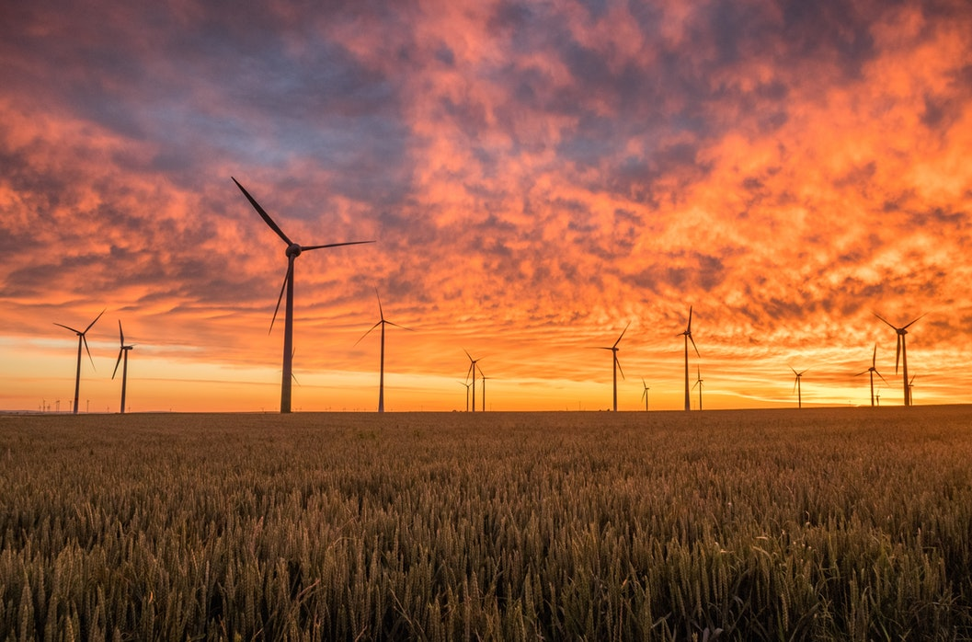
Visions of the Future
Agriculture
Energy
Housing

Slide 2
Class Goal
To envision the world of the future by examining attitudes, new ways of thinking, promising ideas and emerging technologies that will move us towards a sustainable future for all life on planet Earth.
https://www.youtube.com/watch?v=8YQIaOldDU8

Slide 3
Drawdown, The Most Comprehensive Plan Ever Proposed To Reverse Global Warming; Edited by Paul Hawken
Drawdown offers the 100 most substantive solutions to reverse Global Warming, based on meticulous research by leading scientists and policymakers around the world.
Regenerative Agriculture ranks #11 out of 80 solutions in its ability to reduce carbon emissions.

Slide 4
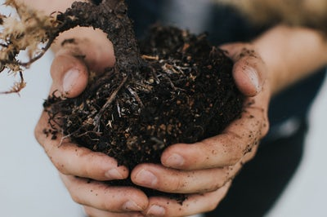
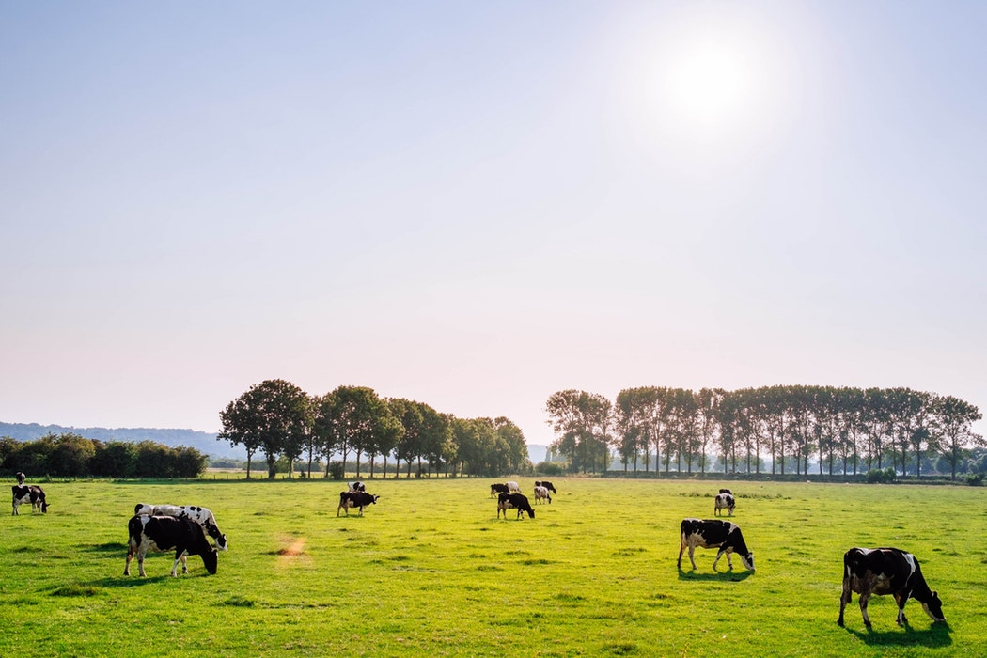
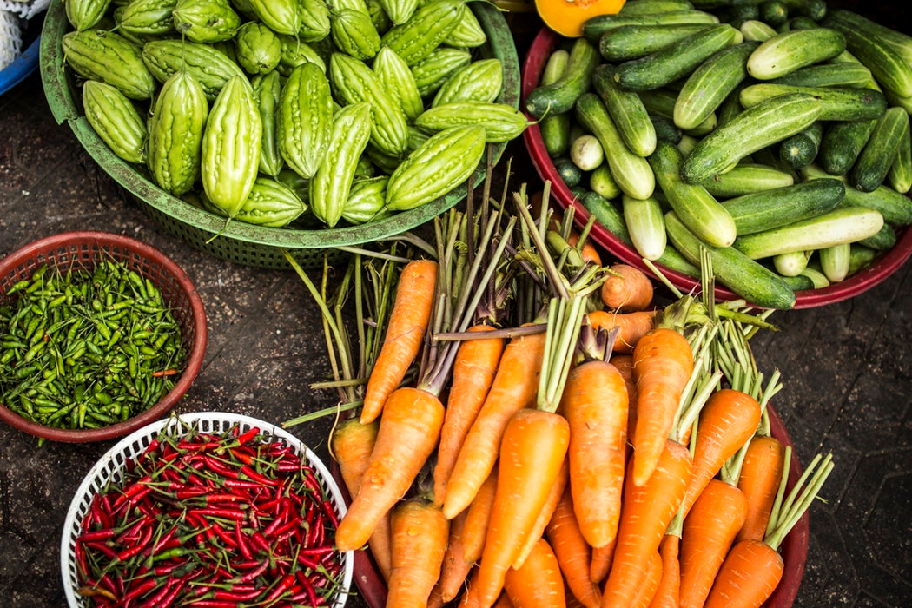
Regenerative Agriculture

Slide 5
Definition :
Regenerative Agriculture practices restore degraded land by employing:
1) No tillage
2) Diverse crop covers
3) In-farm fertility: no external nutrient sources
4) No pesticides or synthetic fertilizers
5) Multiple crop rotation
6) Managed grazing

Slide 6
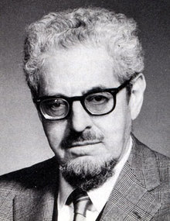
Attitude Shapers and Game Changers
J. I. Rodale: Founder of Rodale, Inc. (1898 – 1971)
https://vimeo.com/221985455

Slide 7
More “Game Changers” in Regenerative Agriculture
Gabe Brown; Regenerative Rancher in North Dakota
You Tube video: Regenerating Our Resources
Joel Salatin; Raises livestock in the Shenandoah Valley of Virginia using holistic methods of animal husbandry, free of potentially harmful chemicals.
You Tube Video: 2015 Ted Talk; Cows, Carbon and Climate
“If you want to make small changes,
change the way you do things.
If you want to make major changes,
change the way you SEE things.”
Don Campbell
Holistic Management Certified Educator, Canada
https://www.youtube.com/watch?time_continue=18&v=JdMSyttMR1Q

Slide 8
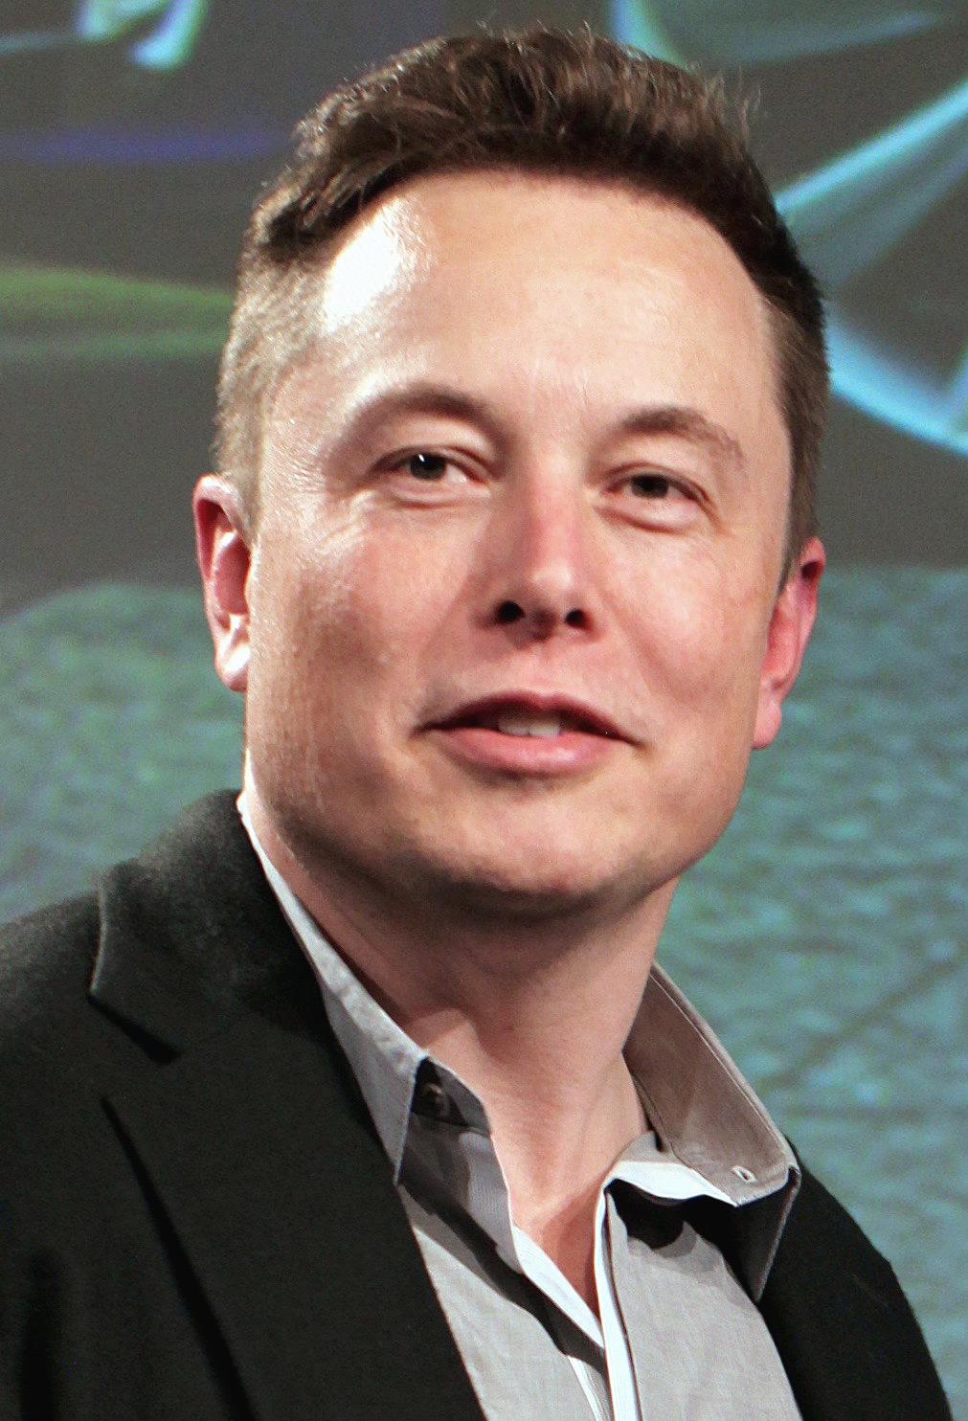
Renewable Energy
Major Game Changer, Elon Musk (born 1971)
His goals include:
Reducing global warming through sustainable energy production and consumption.
Reducing the risk of human extinction by establishing a human colony on Mars.
“Dream no small dreams for they have no power to move the hearts of man.”
Johann Wolfgang von Goethe (1749 -1832)

