Slide 1
Renewable Energy – Drawdown Statistics
Wind Turbines
1) Onshore #2
2) Offshore #22
Solar
1) Solar Farms #8
2) Roof Top Solar #10
Geothermal #18

Slide 2
Cities in US running on 100% renewable electricity report by Walter Einenkel; 10/26/17 ( Source Daily Kos)
Rock Port, Missouri ; 2008 - wind turbines
Burlington, Vermont; 2014 - solar
Kodiak Island, Alaska; 99.7% of power from wind and hydropower
Aspen, Colorado; 2015 - wind, solar and geothermal
Georgetown, Texas; wind and solar.
Greensburg, Kansas; 2009 - wind, geothermal, solar
https://www.google.com/url?sa=t&rct=j&q=&esrc=s&source=web&cd=4&cad=rja&uact=8&ved=0ahUKEwjc5pXDjuzZAhVN2VMKHbCGALUQtwIIOTAD&url=https%3A%2F%2Fwww.youtube.com%2Fwatch%3Fv%3Ddw9BVsE7bm0&usg=AOvVaw19pfKAD1LZdjYlERd4sZLT

Slide 3
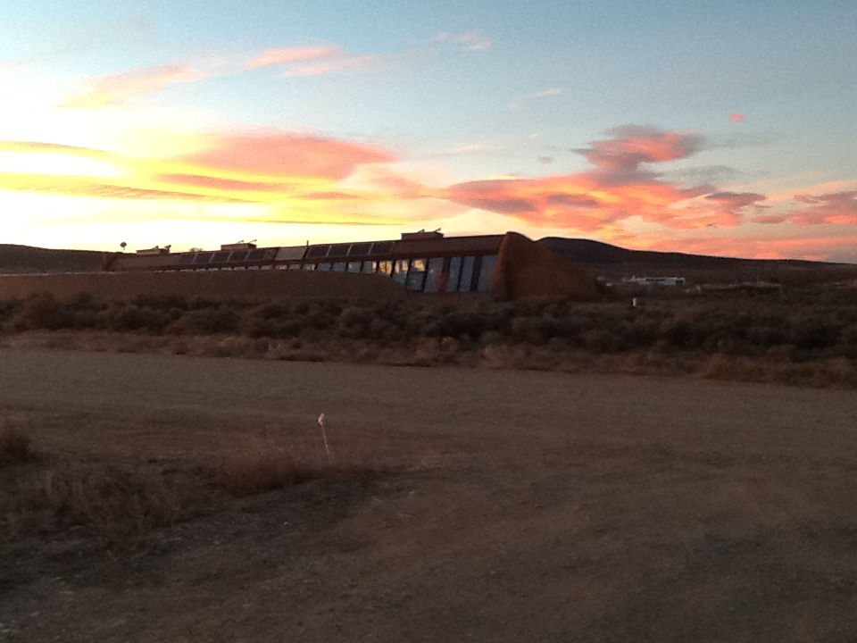
Housing /Buildings
Living Off The Grid

Slide 4
Earthships
Michael Reynolds, Visionary Architect
Goals: To build sustainable housing using
materials indigenous to local areas and
recycled materials whenever possible. Solar,
geothermal and wind power Reynold’s “off
the grid” housing.
https://www.google.com/url?sa=t&rct=j&q=&esrc=s&source=web&cd=1&cad=rja&uact=8&ved=0ahUKEwjoiMTj2oDaAhUMRa0KHRZlAyQQtwIIJzAA&url=https%3A%2F%2Fwww.youtube.com%2Fwatch%3Fv%3DXj5NO32ahB0&usg=AOvVaw37NEQ_urRezPWJdKg3kHLG

