Slide 1
Ecoliterature
American Literature of Nature, Ecology, and the Environment

Slide 2
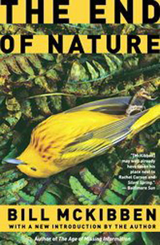
Bill McKibben
from The End of Nature
By Bill McKibben
But, quite by accident, it turned out that the carbon dioxide and other gases we were producing in our pursuit of a better life—in pursuit of warm houses and eternal economic growth and of agriculture so productive it would free most of us from farming—could alter the power of the sun, could increase its heat. And that increase could change patterns of moisture and dryness, breed storms in new places, breed deserts. Those things may or may not have yet begun to happen, but it is too late to altogether prevent them from happening. We have produced the carbon dioxide—we are ending nature.

Slide 3
from “For a Coming Extinction” by W. S. Merwin
Gray whale
Now that we are sending you to The End
That great god
Tell him
That we who follow you invented forgiveness
And forgive nothing…
Tell him that we were made
On another day…
Tell him
That it is we who are important

Slide 4
from Planet of Weeds by David Quamman
So the world's privileged class—that's your class and my class—will probably still manage to maintain themselves inside Homer-Dixon's stretch limo, drinking bottled water and breathing bottled air and eating reasonably healthy food that has become incredibly precious, while the potholes in the road outside grow ever deeper. Eventually the limo will look more like a lunar rover. Ragtag mobs of desperate souls will cling to its bumpers, like groupies on Elvis's final Cadillac.

Slide 5
from Ezra Pound’s Proposition by Robert Hass
And the dam’s great turbine, beautifully tooled
In Lund or Dresden or Detriot, financed
by Lazard Freres in Paris or the Morgan Bank in New York…
Have become hives of shimmering silver
And, down river, they throw that bluish throb of light
Across her cheekbones and her lovely skin.

Slide 6
from “The Peace of Wild Things” by Wendell Berry
I come into the peace of wild things
who do not tax their lives with forethought
of grief. I come into the presence of still water.
And I feel above me the day-blind stars
waiting with their light. For a time
I rest in the grace of the world, and am free.

Slide 7
from “Should the Fox Come Again to My Cabin in the Snow” by Patricia Fargnoli
Then, the winter will have fallen all in white
and the hill will be rising to the north,
the night also rising and leaving,
dawn light just coming in, the fire out.
Down the hill running will come that flame
among the dancing skeletons of the ash trees.
I will leave the door open for him.

Slide 8
from “the beginning of the end of the world” by Lucille Clifton
maybe the morning the roaches
walked into the kitchen
bold with they bad selves
marching up out of the drains
not like soldiers like priests
grim and patient in the sink
and when we ran the water
trying to drown them as if they were
soldiers they seemed to bow their
sad heads for us not at us

Slide 9
from The Ninemile Wolves by Rick Bass
They eat everything, when they kill, even the snow that soaks up the blood.
This all goes on usually at night. They catch their prey from behind, often, but also by the nose, the face, the neck whatever they can dart in and grab without being kicked. When the prey pauses, or buckles, it's over; the prey's hindquarters, or neck, might be torn out, and in that manner, the prey flounders. The wolves swarm it, then. They don't have thumbs. All they've got is teeth, long legs, and—I have to say this—great hearts.

Slide 10
from The Last Panda by George B. Schaller
While her powerful molars sectioned and crushed the stem, she glanced around for another, her movements placid and skillful, a perfect ecological integration between panda and bamboo…
From below, near where forest gave way to field, came the sound of an ax. The bamboo around her like armor against intruders, she listened and then moved away, shunning any possible confrontation. She traveled on a private path along the slope, insinuating herself from thicket to thicket, moving like a cloud shadow, navigating with precision through the sea of stems, with only her tracks a record of her silent passing.

Slide 11
from The Ecology of Magic by David Abram
I might have been able to reorient myself, to regain some sense of ground and gravity, were it not for a fact that confounded my senses entirely: between the constellations below and the constellations above drifted countless fireflies, their lights flickering like the stars, some drifting up to join the clusters of stars overhead, others, like graceful meteors, slipping down from above to join the constellations underfoot, and all these paths of light upward and downward were mirrored, as well, in the still surface of the paddies. I felt myself at times falling through space, at other moments floating and drifting. I simply could not dispel the profound vertigo and giddiness; the paths of the fireflies, and their reflections in the water's surface, held me in a sustained trance… Fireflies!

Slide 12
from The Song of the White Pelican by Jack Turner
[E]very time they land on the river, it looks like a disaster. They drop the backs of their huge wings, throw out their feet like wheels, and land with a controlled crash—like a 747. Every time, they almost nose over; every time, they just make it. Then, to regain their composure, they tuck their bills into their chests with that snotty satisfied-English butler look and casually paddle off after more trout, buoyant as a well-greased fly.

Slide 13
from If the Owl Calls Again by John Haines
[If the owl calls again] at dusk from the island in the river, and it’s not too cold, I’ll wait for the moon to rise, then take wing and glide to meet him. We will not speak, but hooded against the frost soar above the alder flats, searching with tawny eyes. And then we’ll sit in the shadowy spruce and pick the bones of careless mice, while the long moon drifts toward Asia and the river mutters in its icy bed. And when the morning climbs the limbs we’ll part without a sound, fulfilled, floating homeward as the cold world awakens.

Slide 14
from Eagle Poem by JOY HARJO
Like eagle that Sunday morning
Over Salt River. Circled in blue sky
In wind, swept our hearts clean
With sacred wings.
We see you, see ourselves and know
That we must take the utmost care
And kindness in all things…

Slide 15
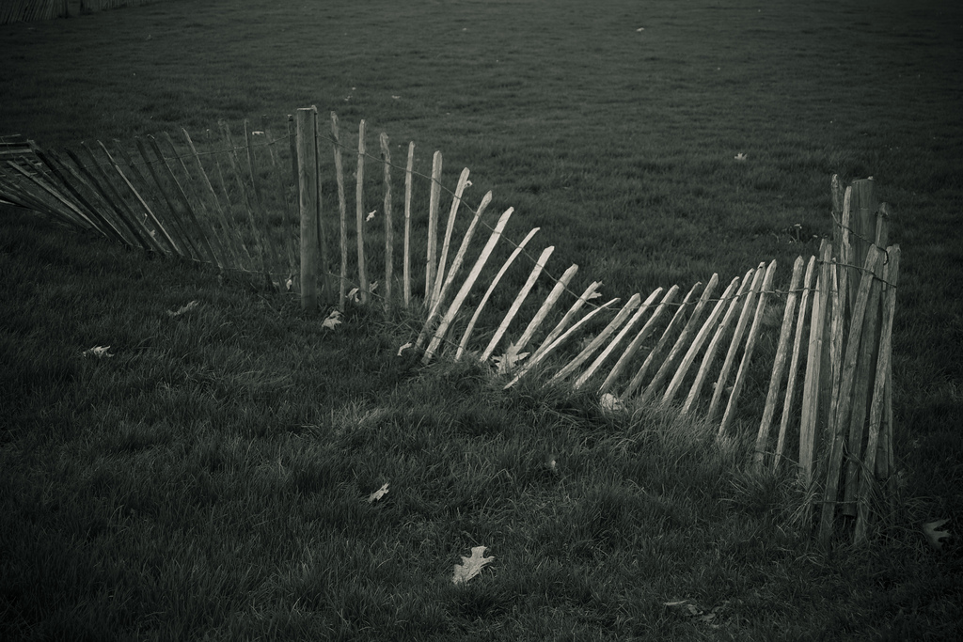
from “The Supple Deer” by Jane Hirshfield
The quiet opening
between fence strands
perhaps eighteen inches.
Antlers to hind hooves,
four feet off the ground,
the deer poured through.
No tuft of the coarse white belly hair left behind.
I don’t know how a stag turns
into a stream, an arc of water.
I have never felt such accurate envy.
Not of the deer:
To be that porous, to have such largeness pass through me.

Slide 16
from Heart and Blood: Living with Deer by Richard Nelson
…Still lying on one side, she raises her uppermost hind leg off the ground, arches her neck, and reaches her head back. Then, out from beneath the flared white tail slips something long and wet and shining and very dark.
I want to jump and shout aloud for the joy of it, but instead I hold the binoculars to my eyes, arms aching and muscles shivering.
Half visible beside the mother's loins, a dusky-brown mass gathers itself together, moves in confused, spasmodic jerks, and becomes a fawn—a tiny, throbbing, trembling, living fleck of earth.

Slide 17
from “Ecology” by Jack Collom
Surrounded by bone, surrounded by cells,
by rings, by rings of hell, by hair, surrounded by
air-is-a-thing, surrounded by silhouette, by honey-wet bees, yet
by skeletons of trees, surrounded by actual, yes, for practical
purposes, people, surrounded by surreal
popcorn, surrounded by the reborn: Surrender in the center
to surroundings…

Slide 18
from “On the rocks” by Camille T. Dungy
…I said I thought if I paddled far enough from the ship I might hear icebergs melting. I said, they said we could hear gas escaping from the ice. I said, they said it would sound a bit like a soda can being slowly opened. I said I thought it would sound like what it might sound like to find myself paddling through a giant highball of vodka on the rocks, the can of tonic being opened, everything I needed right there. You wouldn't catch me out there, she said, floating with nothing but a life vest and a kayak. I said, quiet. I want to hear what quiet really sounds like.

Slide 19
from “West Texas” by B. H. Fairchild
…my father kneeling in the road,
then looking up. Stay put, let the land
claim you, he always said. But here
men own you and the land you drill
and you move on. My one headlight
dims in the morning light. The other
mirrors back the road, the whitening sky.
Far ahead a hawk is sweeping
into view on wide, black wings.

Slide 20
from The Ecology of Magic by David Abram
…I walked into my room chuckling to myself: the balian and his wife had gone to so much trouble to placate the household spirits with gifts, only to have their offerings stolen by little six-legged thieves. What a waste! But then a strange thought dawned on me: what if the ants were the very "household spirits" to whom the offerings were being made?

Slide 21
from “My Dear Affluent Reader,” by C. D. Wright
Welcome to the Pecanland Mall. Sadly, the pecan grove had to be dozed to build it. Home Depot razed another grove. There is just the one grove left and the creeper and the ivy have blunted its sun. The uglification of your landscape is all but concluded. We are driving around the shorn suburb of your intelligence, the photographer and her factotum. Later we’ll walk in the shadows of South Grand. They say, in the heyday of natural gas there were houses with hinges of gold. They say so. We are gaining on the cancerous alley of our death. Which, when all is said or unsaid, done or left undone, shriven or unforgiven, this business of dying is our most commonly held goal.
Ready or not. 0 exceptions.
Don’t ask.

Slide 22
from “Eating a Mountain” by Deborah A. Miranda
Eating this deer means
eating this mountain:
acorns, ash, beech, dogwood,
maple, oak, willow, autumn olive…
carve up that deer
with gratitude, artistry, prayer,
render a wild and sacred animal
into wild, sacred sustenance.
How we eat this deer is a debt
that comes due on the day
we let this mountain
eat us.

Slide 23
from The Legacy of Luna by Julia Butterfly Hill
…So the trophy is not just for that car's driver, it represents the whole effort of all the people who worked on the car. And so with this movement: a victory comes from the efforts of everyone, not just me. Our trophy will be to find permanent protection for all the old growth while we save Luna. And we will all share that prize.

Slide 24
from Inspirations for Sustaining Life on Earth by Calvin DeWitt
The Lord bless you and shamar you" (Numbers 6:24). The people who are blessed by their pastor or rabbi with this widely used benediction expect God to keep them, not as pickles in a jar, but keep them in all of their dynamic integrity.

Slide 25
from Blessed Unrest by Paul Hawken
What has changed recently, and has offered evidence that hope may be a rational act despite the onslaught of countervailing data, is the use of connectivity. Individuals are associating, hooking up, and identifying with one another… [T]hey are forming units, inventing again and again pieces of a larger organism… and assembling these into a mosaic of activity as if they were solving a jigsaw puzzle without ever having seen the picture on its box. The insanity of human destructiveness may be matched by an older grace and intelligence that is fastening us together in ways we have never before seen or imagined.

Slide 26
from “For the Children” by Gary Snyder
stay together
learn the flowers
go light

Slide 27
from “The Summer Day” by Mary Oliver
This grasshopper, I mean—
the one who has flung herself out of the grass,
the one who is eating sugar out of my hand,
who is moving her jaws back and forth instead of up and down—
who is gazing around with her enormous and complicated eyes…
Tell me, what else should I have done?
Doesn’t everything die at last, and too soon?
Tell me, what is it you plan to do
With your wild and precious life?

Slide 28
Photo Credits All Creative Commons (CC 2.0 Generic)
1. N/A
2. N/A
3. Charlie Stinchcomb, Extremely Close Gray Whale Head
4. Rxback, Cadillac Elvis
5. Dr. Butoni, Boy, Girl, or Lady (Bangkok Thailand)
6. Ian Sane, Beside Still Waters
7. Alan Krakauer, Toolik-Fox-in-snow 1782
8. Chris Gladdis, Giant cockroach
9. Claudia Dea, my wolf friend
10. Pedro Cancion, Sulin
11. Mike Lewinski, Fireflies and Star Trails No. 1
12. Ken Slade, A Landing Close-Up
13. Þórunn Þorsteinsdóttir. From Iceland. Fantasy
14. Kenneth Cole Schneider Eagle Flying 20090203
15. Nigel Green, 300D_0352
16. AgriLife Today Follow, Hidden fawn
17. Jim, the Photographer, "This machine surrounds hate and forces it to surrender."
18. Stuart Webster, Ameretto Sour
19. Stuart Seeger, Sunrise: West Texas Style
20. Magalie L'Abbé, ants!
21. Nick Bastian, Pecan Grove Village Tempe AZ
22. Nicholas Chan, IMG_0332
23. Idee Contagiose, JULIA “BUTTERFLY” HILL: VIVERE DUE ANNI SU UN ALBERO
24. gizem boyacioglu, Pickle in a Jar
25. Sandor Weisz, Jigsawing
26. Srasteria, Wildflower_2601

